Slide 1
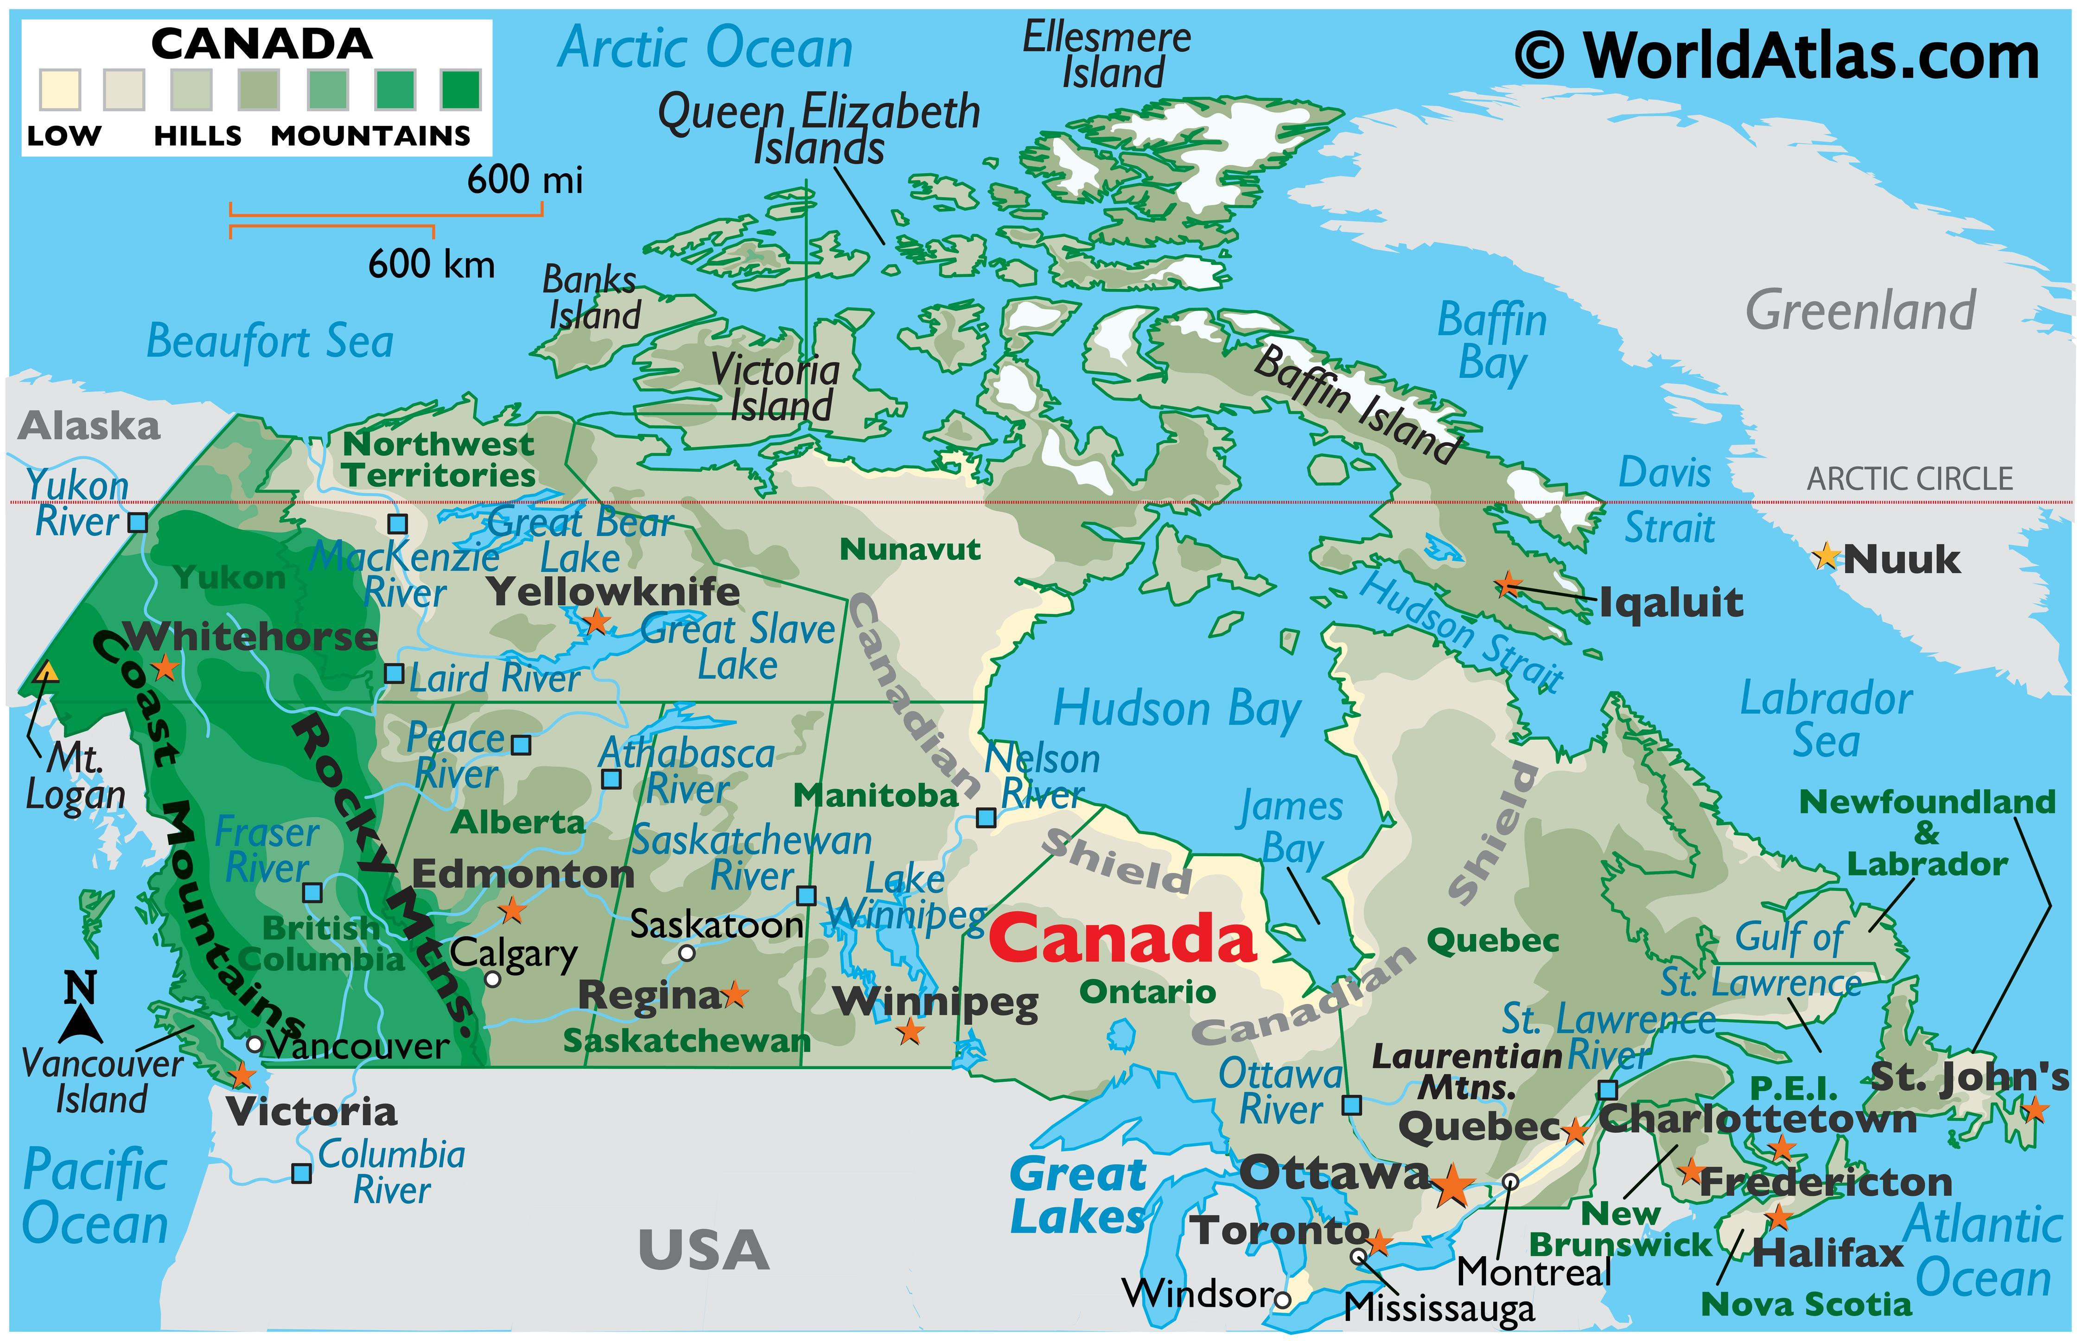
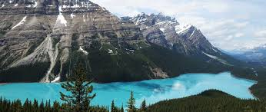
Canada
March 15-17

Slide 3
SS6G4 Locate selected features of Canada.
Locate on a world and regional political-physical map: the St. Lawrence River, Hudson Bay, Atlantic Ocean, Pacific Ocean, the Great Lakes, Canadian Shield, and Rocky Mountains.
b. Locate on a world and regional political-physical map Canada and the province of Quebec.
SS6G5 Explain the impact of location, climate, distribution of natural resources, and population distribution on Canada.
a. Describe how Canada’s location, climate, and natural resources impact trade and affect where people live.
SS6G6 Explain the impact of environmental issues in Canada.
a. Explain the causes and effects of pollution and acid rain in Canada to include the Great Lakes.
b. Explain the causes and effects of the extraction of natural resources on the Canadian Shield (e.g., mining and logging).

Slide 4
SS6H2 Describe Quebec’s independence movement.
SS6CG2 Explain citizen participation in the Canadian government. a. Explain the role of citizens in choosing the leader of Canada (parliamentary democracy)
SS6E1 Analyze different economic systems.
a. Compare how traditional, command, and market economies answer the economic questions of 1-what to produce, 2-how to produce, and 3-for whom to produce.
b. Explain that countries have a mixed economic system located on a continuum between pure market and pure command.
c. Compare and contrast the basic types of economic systems found in Mexico, Cuba, and Brazil.
SS6E2 Give examples of how voluntary trade benefits buyers and sellers in Latin America.
Explain how specialization encourages trade between countries.
b. Compare and contrast different types of trade barriers, such as tariffs, quotas, and embargos.
c. Explain why international trade requires a system for exchanging currencies between nations.
d. Explain the functions of the United States-Mexico-Canada Agreement (USMCA).

Slide 5
 | Monday 13 | Tuesday 14 | Wednesday 15 | Thursday 16 | Friday 17
Focus Standard(s) | No School | Power Up (work from home) | SS6G5,6 | SS6G5,G6 | SS6G5,G6
Learning Target(s) |  |  | Climate, Resources, Environmental Issues | Climate, Resources, Environmental Issues | Climate, Resources, Environmental Issues
Opening |  |  | Canada Map(Practice) | Canada Video | Canada Map(Practice)
Work Session |  |  | Cloze Notes (Canada) Textbook p.232-250 Workbook | Cloze Notes (Canada) Textbook p.232-250 Workbook | Cloze Notes (Canada) Textbook p.232-250 Workbook
Closing |  |  | TOD | Think-Pair-Share | Group Discussion
Minor Assignments Due |  |  |  |  | Quiz
Major Assignments Due
Current Relearning & Reassessment Assignments (with due dates) |  | Continue to have students study and complete any missing graded assignments
Vocabulary
Upcoming Major Assignments

Slide 7
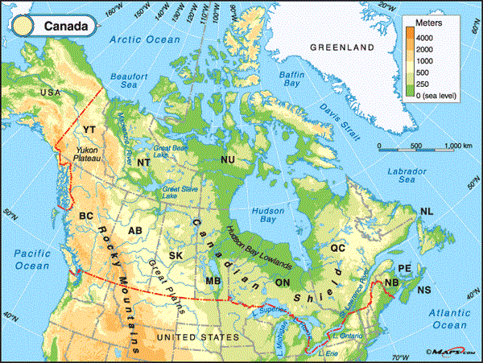
Locate on a world and regional political-physical map: the St. Lawrence River, Hudson Bay, Atlantic Ocean, Pacific Ocean, the Great Lakes, Canadian Shield, and Rocky Mountains.

Slide 8
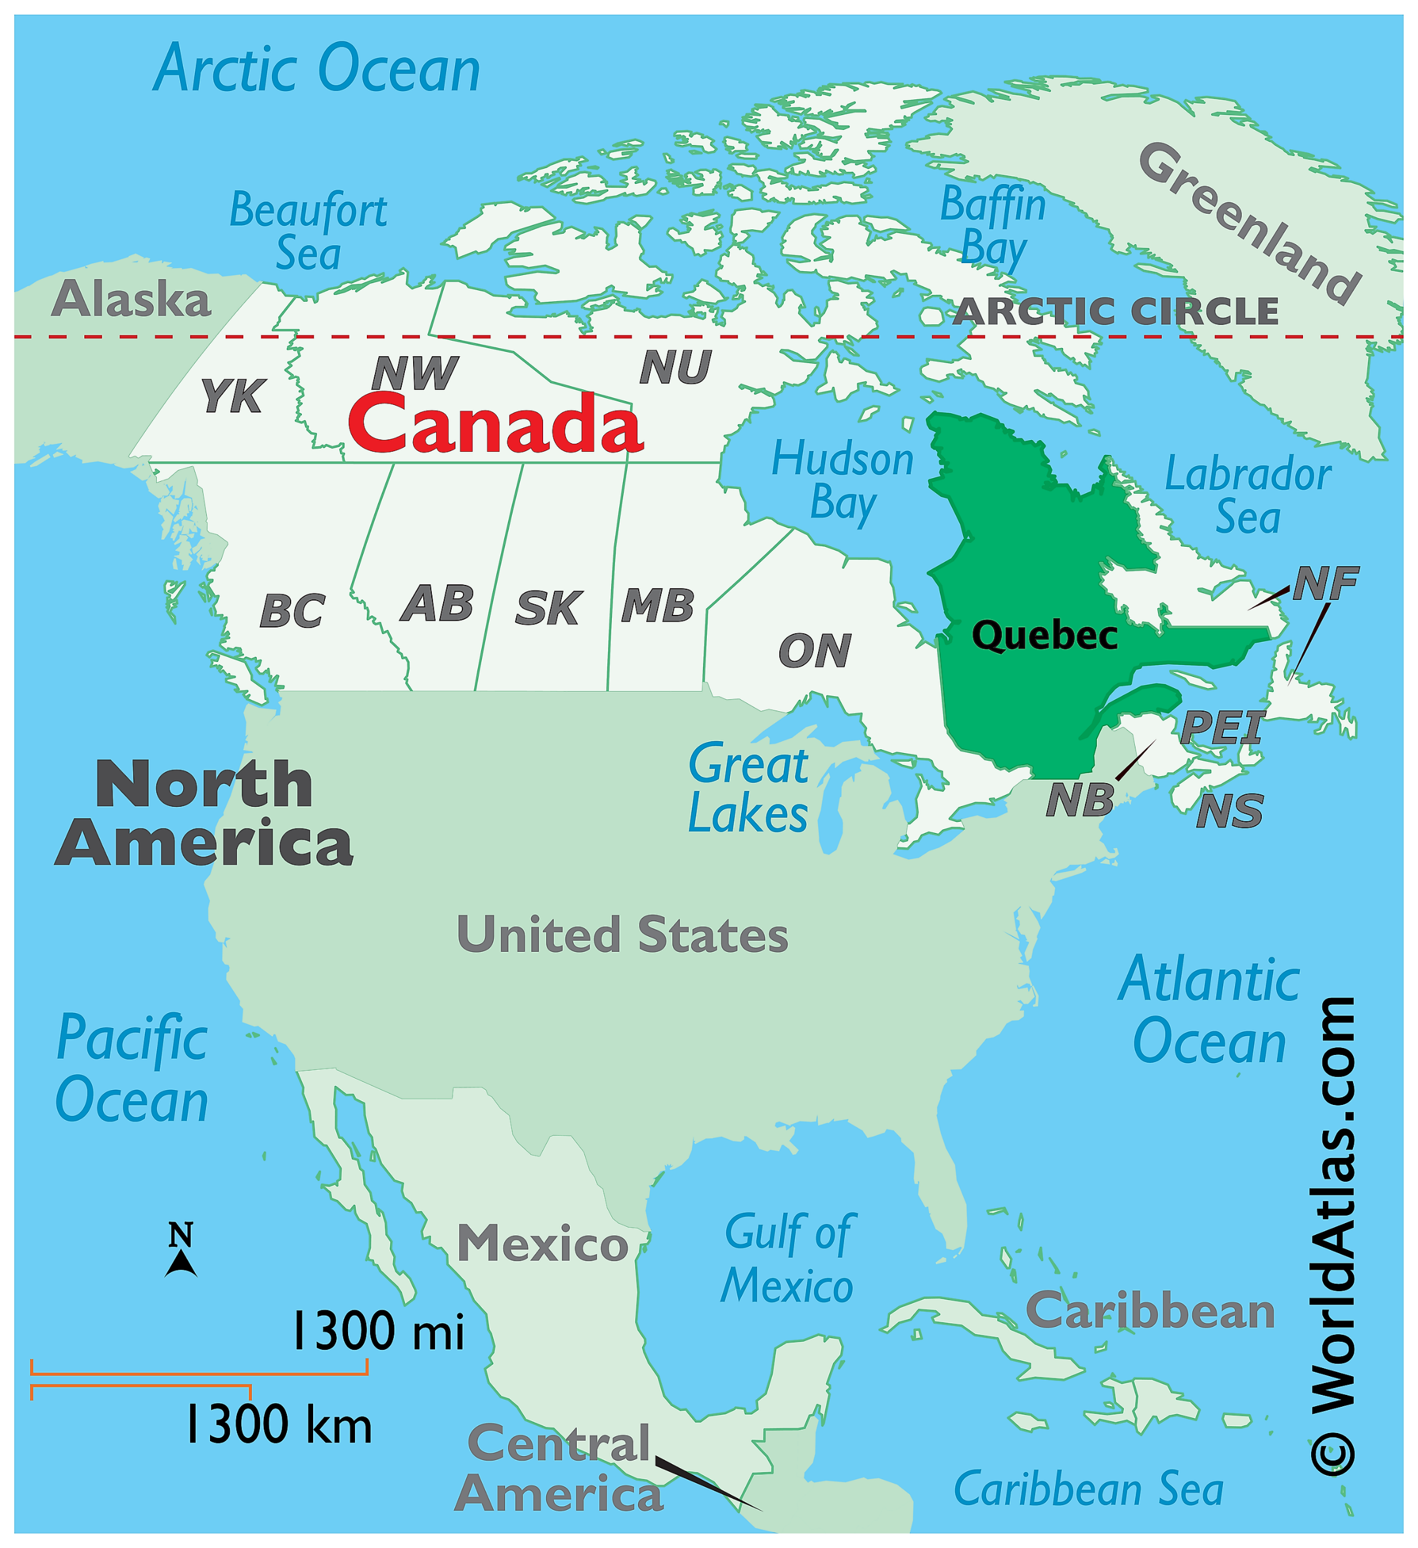
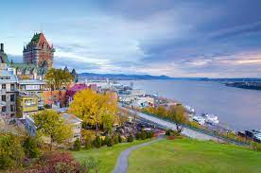
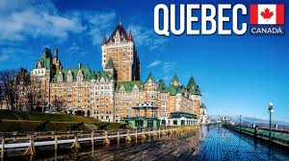

Slide 9
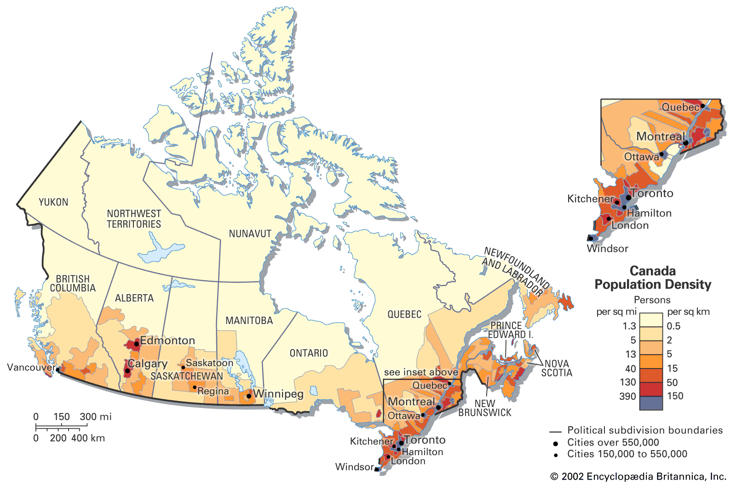

Slide 10
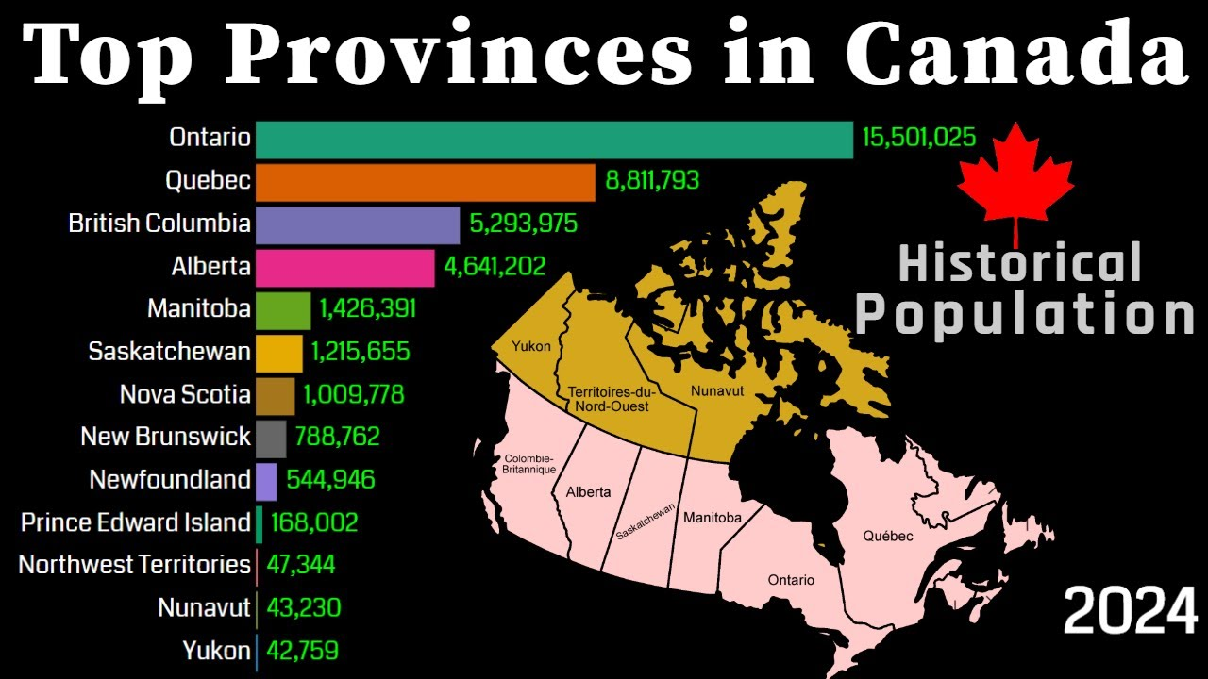

Slide 12
